Slide 1
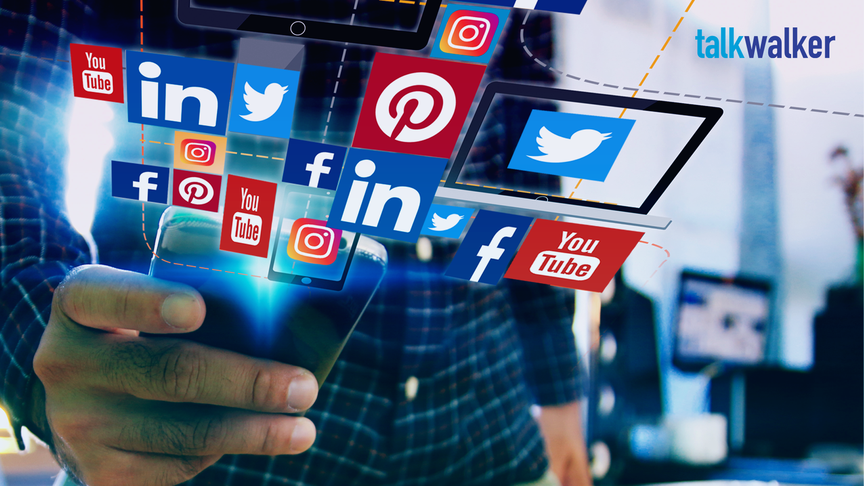
How Social Media is changing our Lives
A Reflection on the Digital Age
This Photo by Unknown Author is licensed under CC BY-SA-NC

Slide 2

Introduction :
“From connection to obsession…”
In this presentation, we will understand what social media is doing to our minds and lives.
Why it’s relevant in today’s

Slide 3
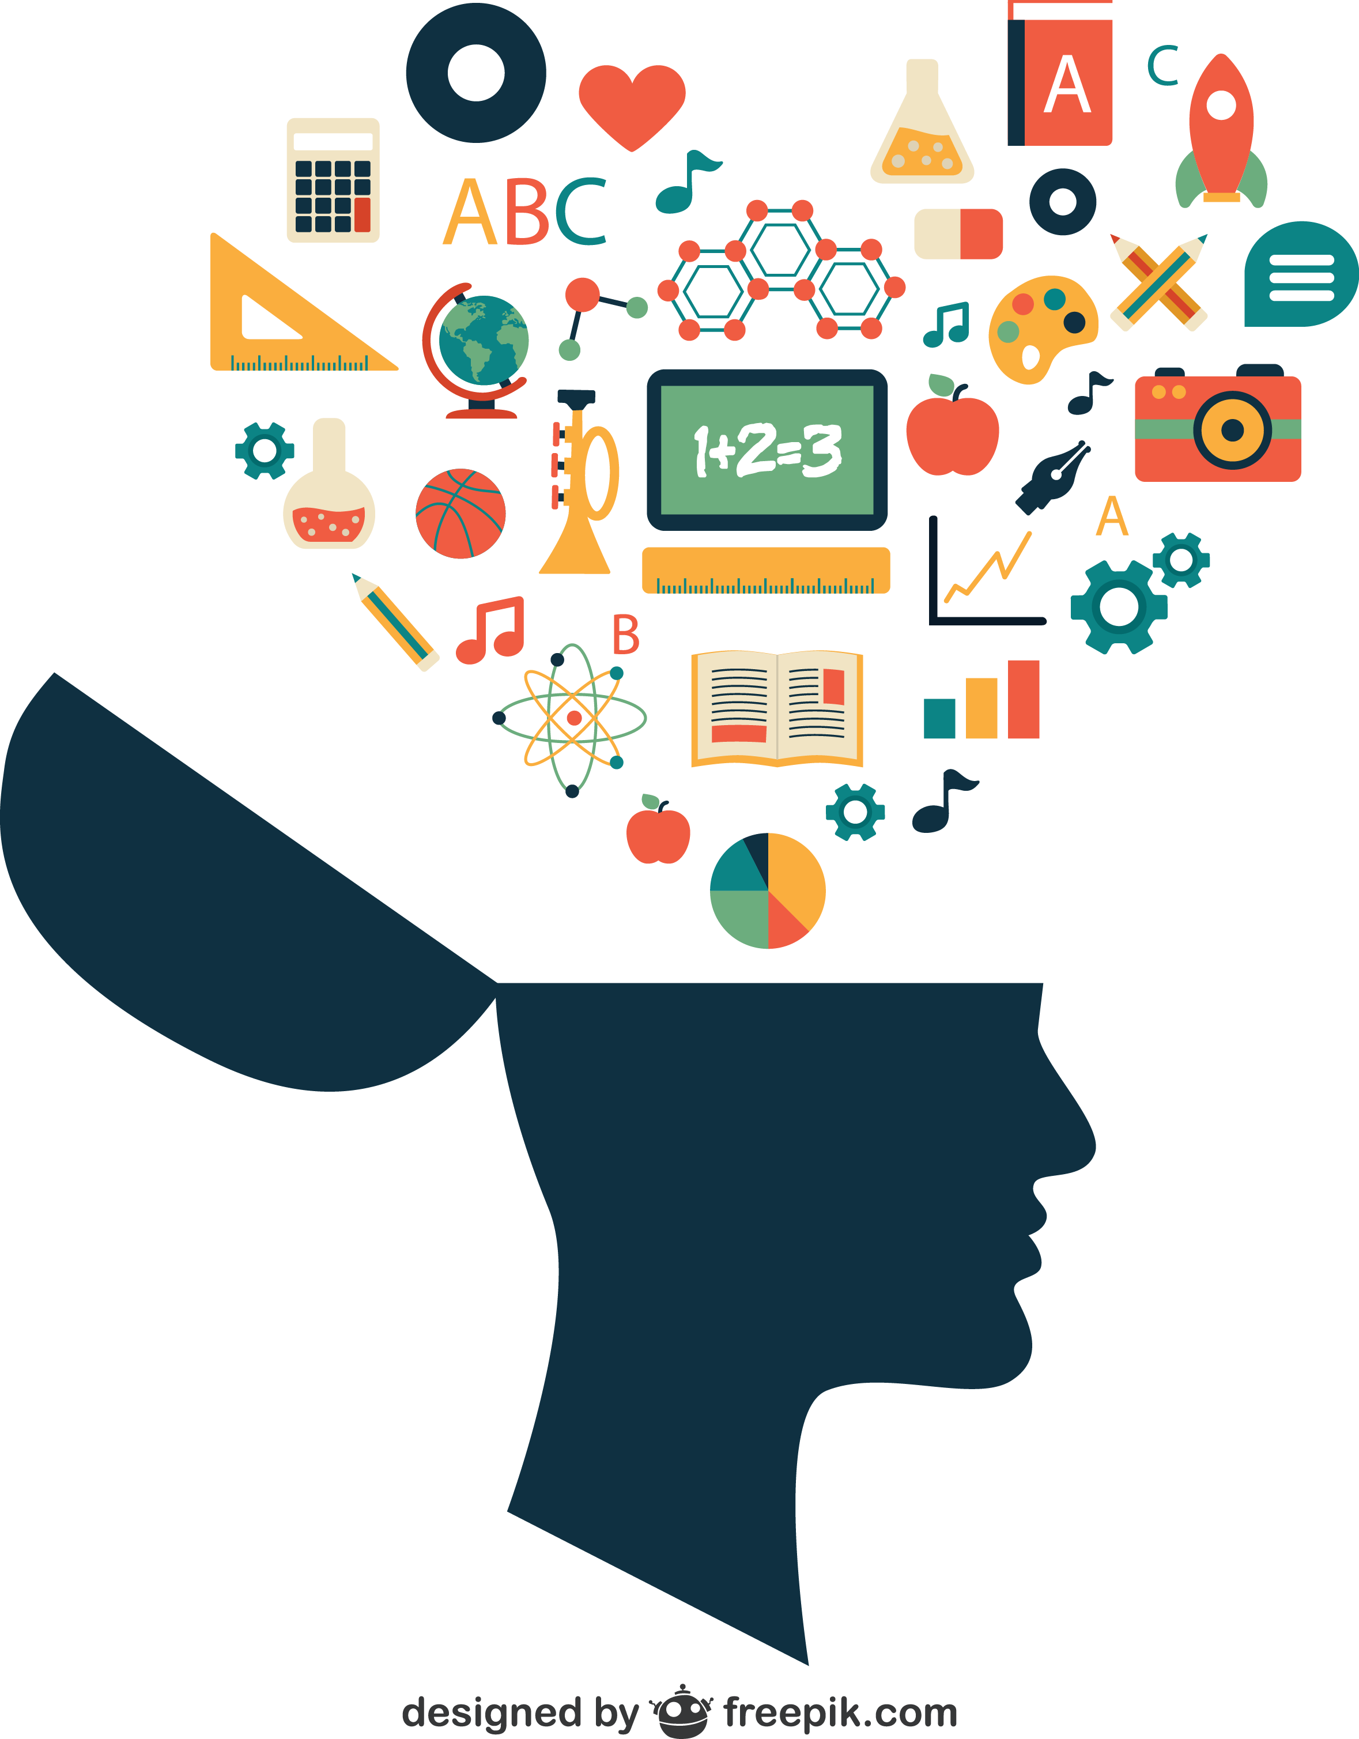
Positive Impacts
Global connectivity
Platform for creativity & expression
Raising awareness ( e.g. social movements)
Business growth and branding
This Photo by Unknown Author is licensed under CC BY-NC

Slide 4

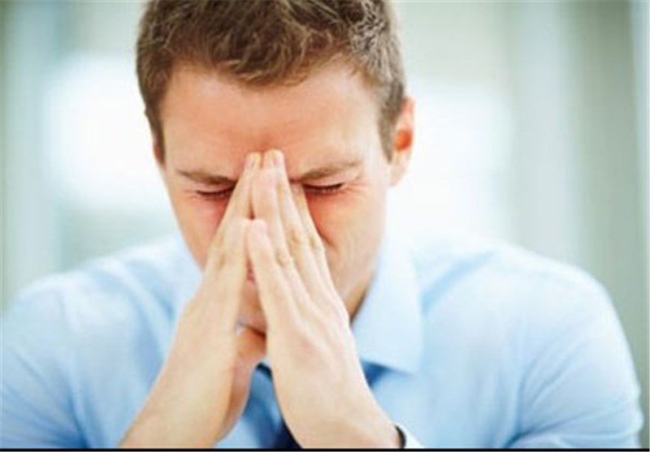
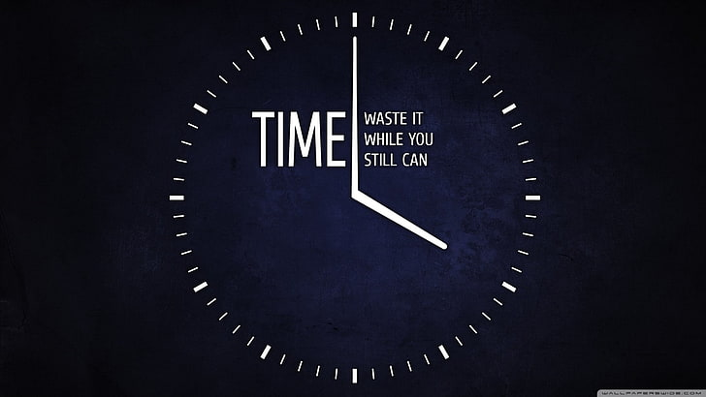

Negative Impacts
Addiction and time-wasting
Fake news and misinformation
Cyberbullying and trolling
Decline in mental health (anxiety, comparison)

Slide 5
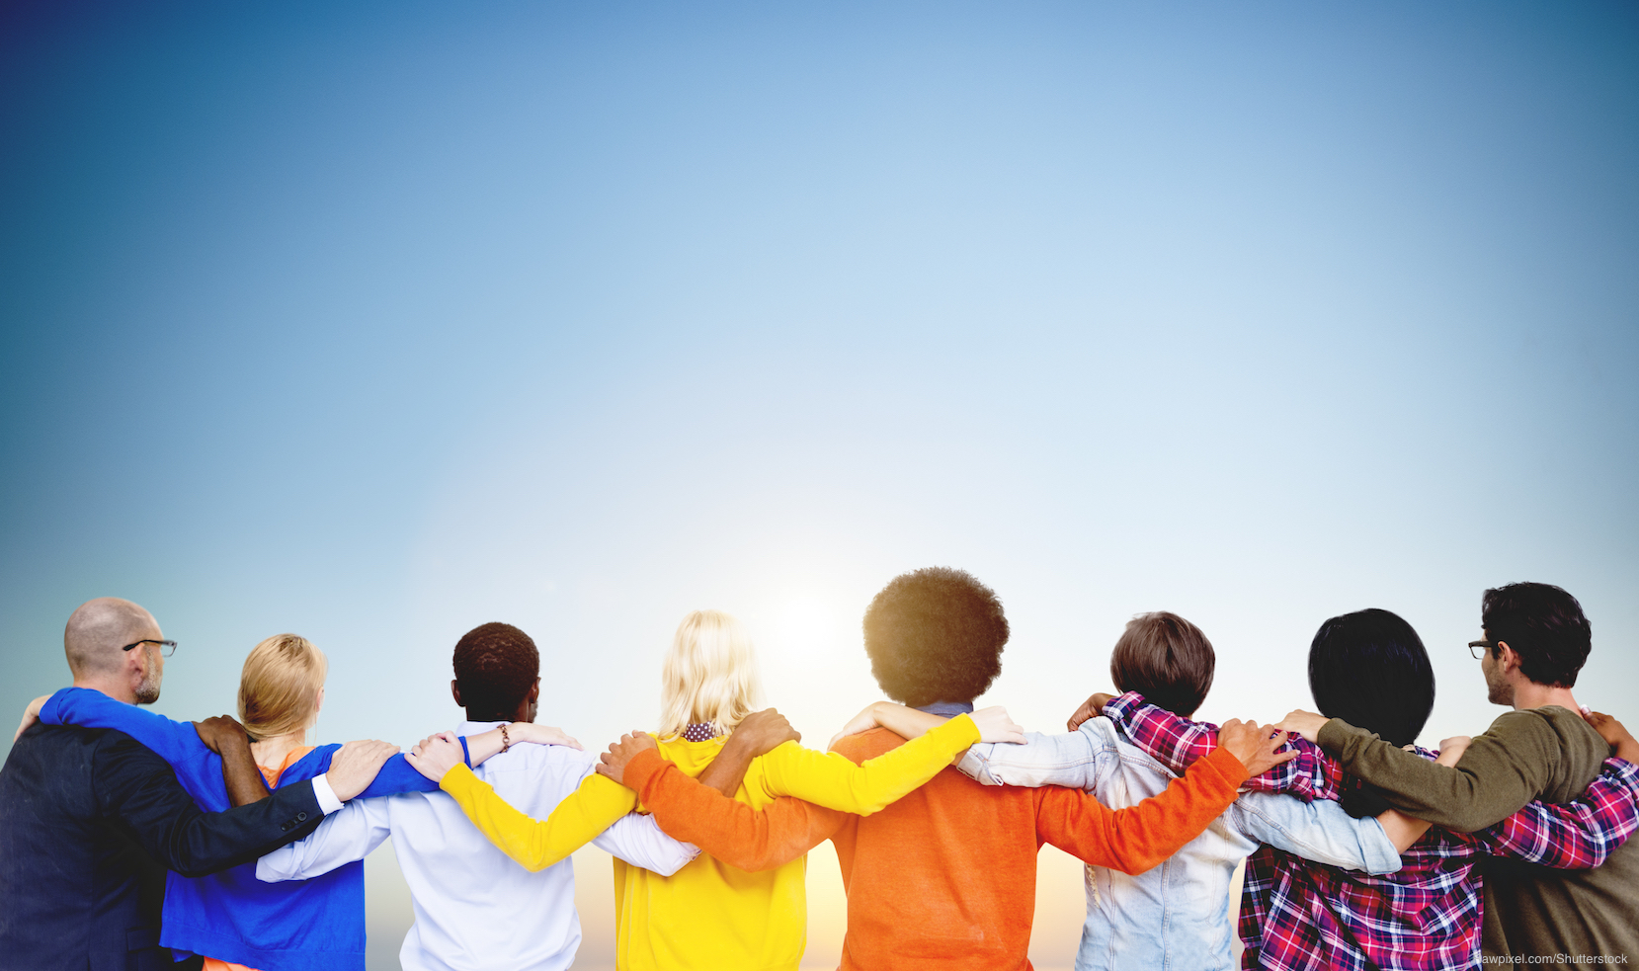
Impact on Relationships
Less real-life conversation
More online validation
Attention shift in family/ friend gatherings

Slide 6
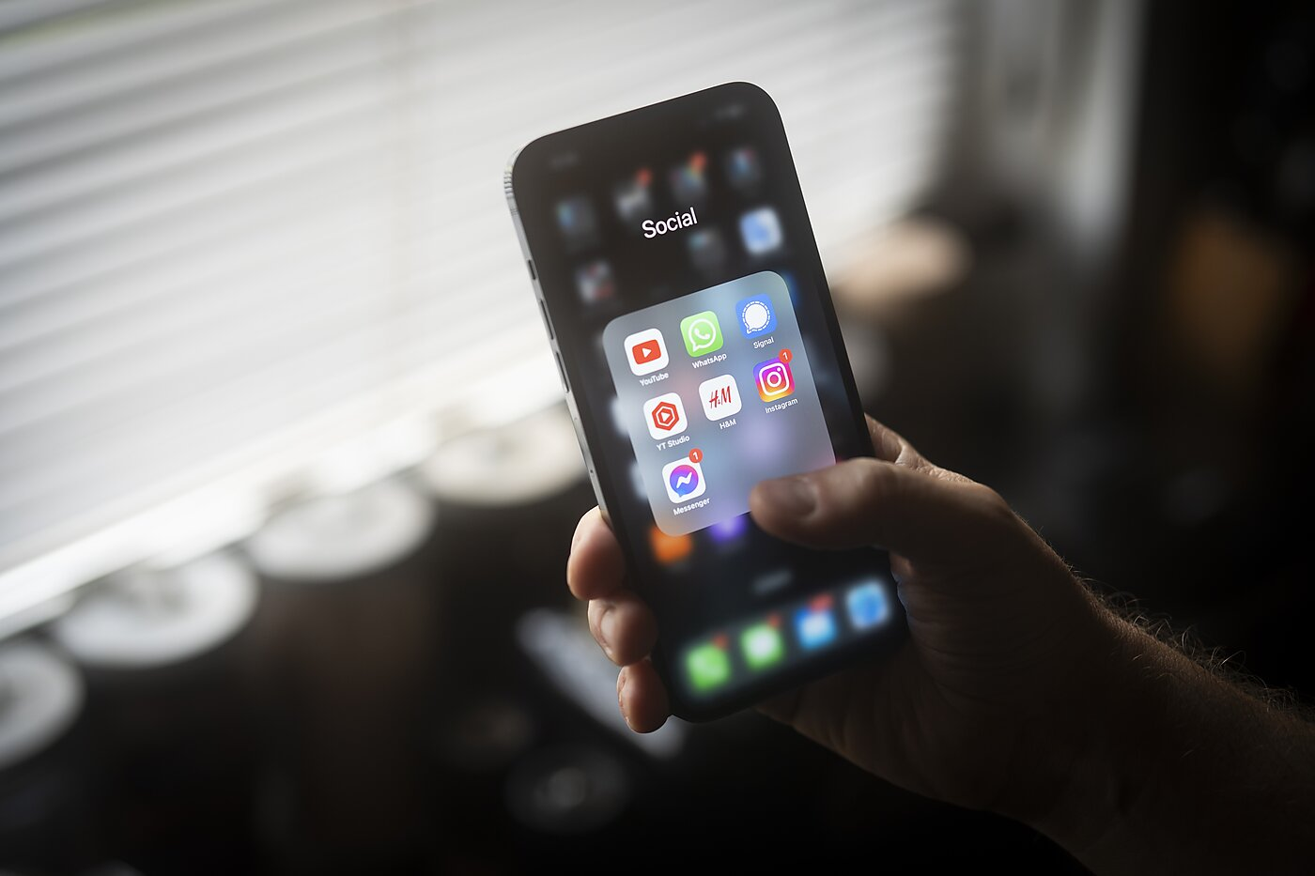
Conclusion
Social media is powerful – it’s up to us it well
It connects us, informs us, entertains us.
But if we are not careful, it can also distract and harm us.

Slide 7
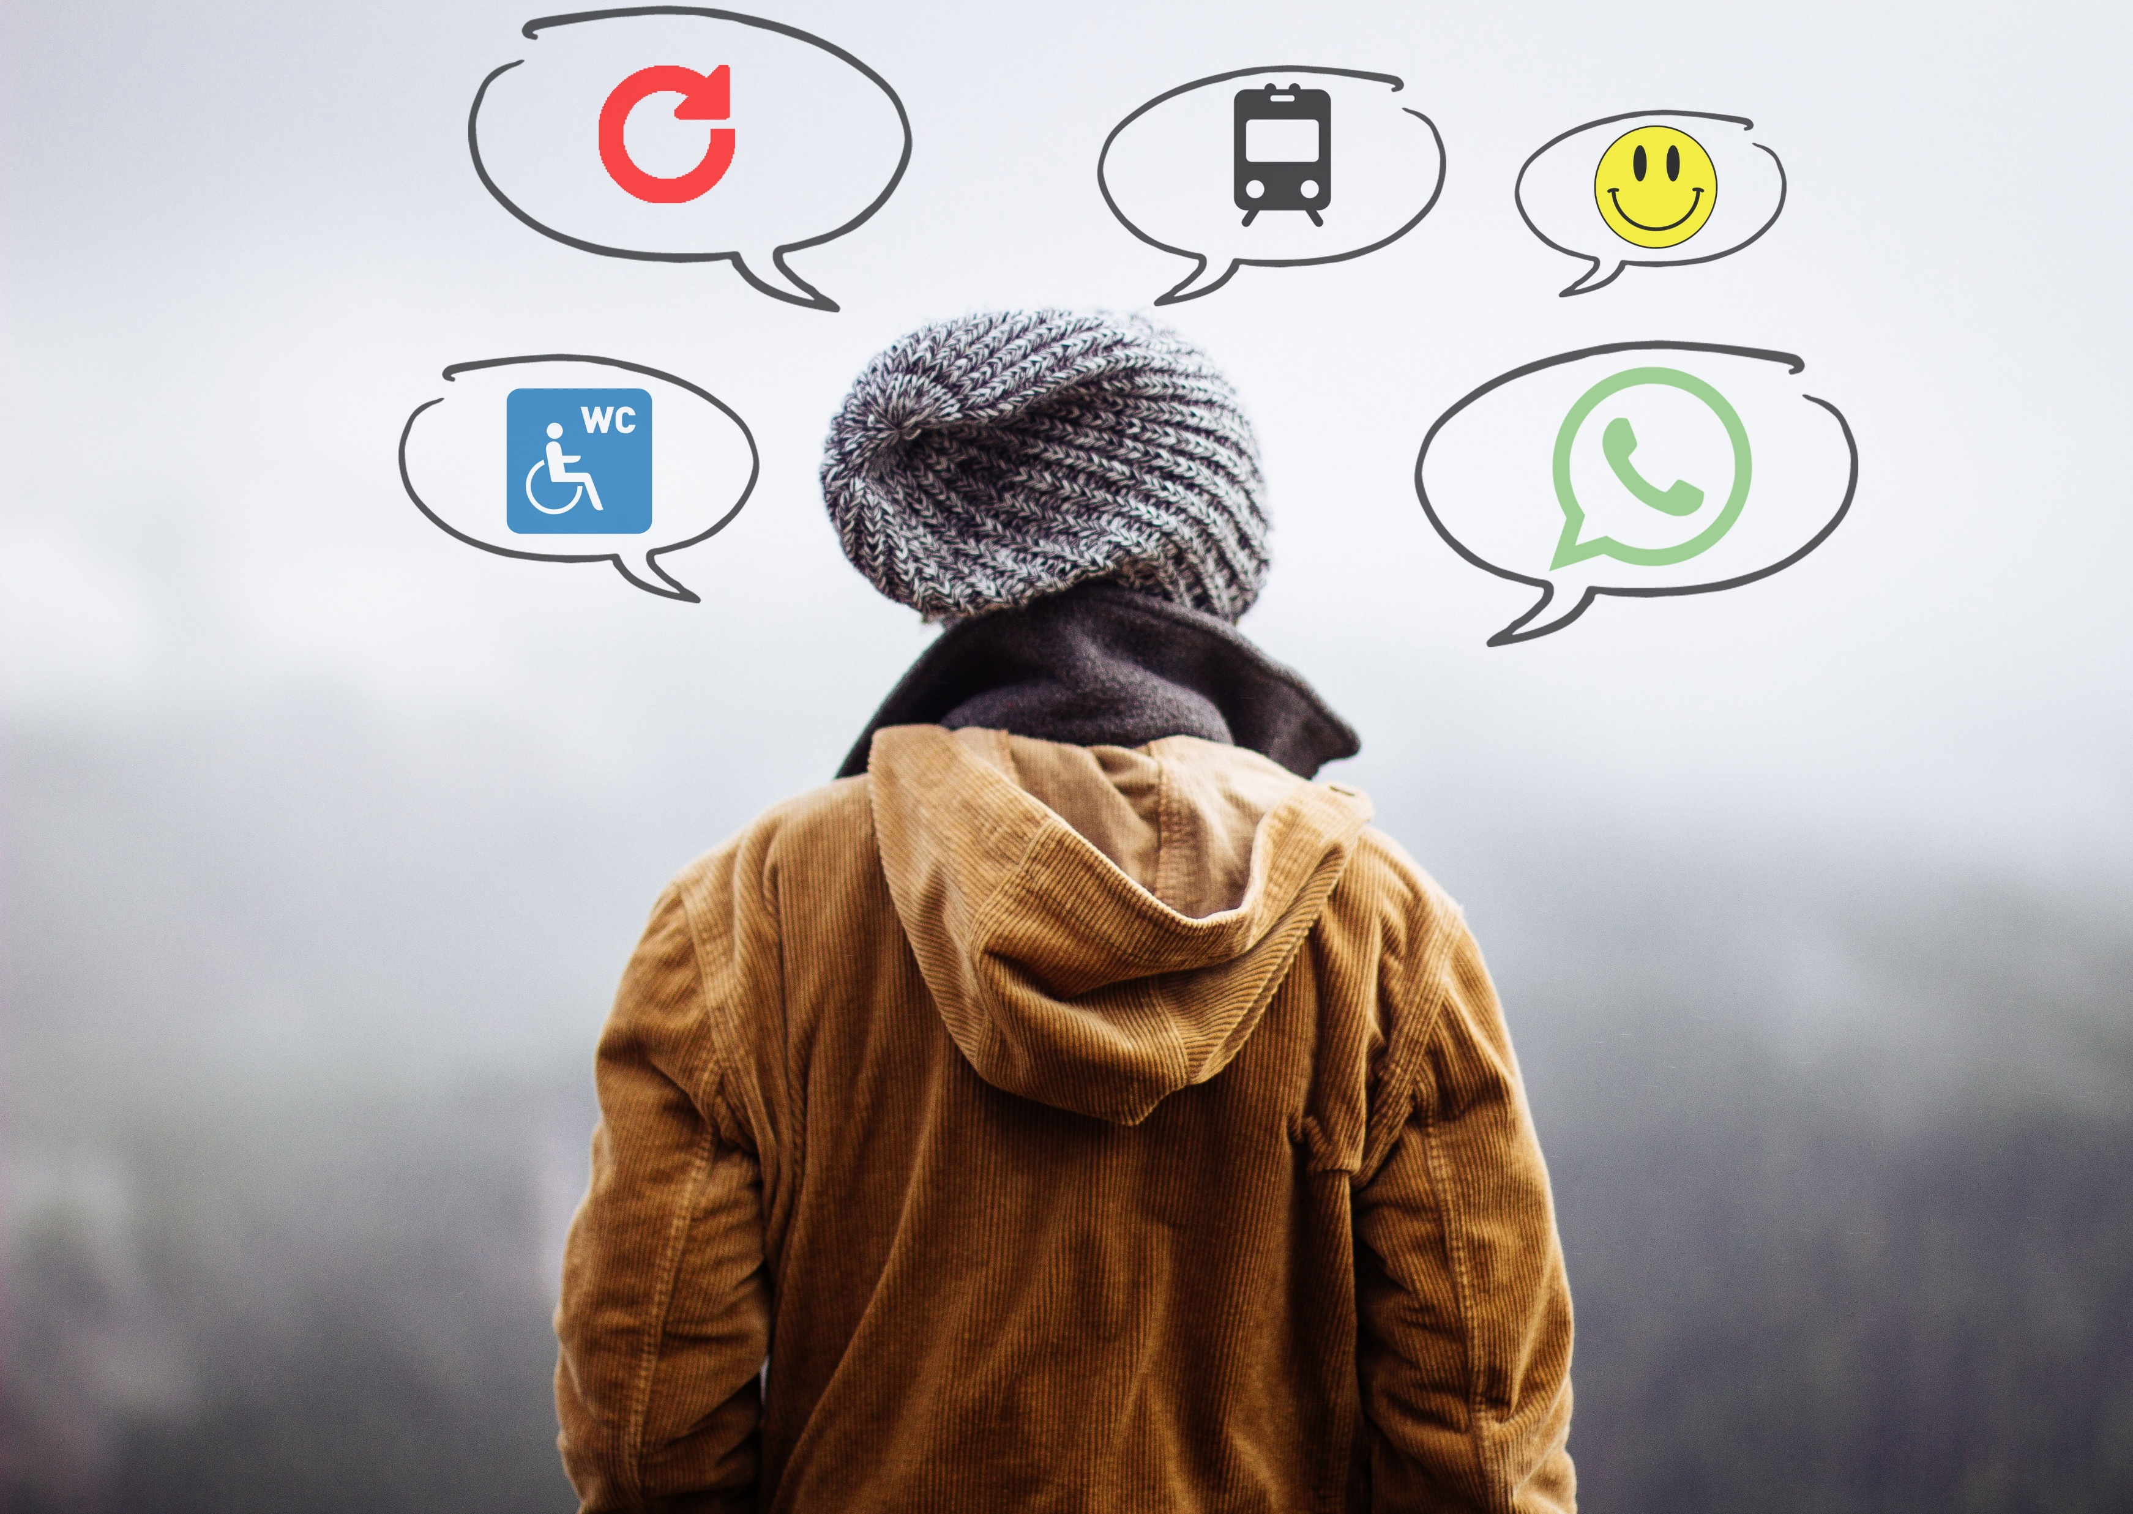
Thank you
“Thank you for your attention!”
“ Social media should improve your life, not become your life.”

